Slide 1
Training on energy audits as an Energy Efficiency DRIVER for the automotive sector
[insert name of event] | [insert location], [date of event]
[name of presenter] – [name of organisation]

Slide 2
PROJECT PARTNERS
CIRCE – Spain, Zaragoza
Fraunhofer ISI – Germany, Karlsruhe
POLITO – Italy, Torino
EPROPLAN – Germany, Stuttgart
SINERGIE – Italy, Reggio Emilia
ENGIE – France, Courbevoie
SERNAUTO – Spain, Madrid
AEN – Germany, Karlsruhe
MESAP – Italy, Torino
MOV‘EO – France, St. Etienne
EPC – Germany, Berlin
MERIT – Belgium, Brussels
11
12
2,8
6
4
10
3,9
5
1
7

Slide 3
ENERGY CONSUMPTION IN THE AUTOMOTIVE INDUSTRY

Slide 4
ENERGY CONSUMPTION IN THE AUTOMOTIVE INDUSTRY
The European automotive industry is growing at 4,3% a year (Vosta and Kocourek, 2017)
In general, the automotive sector uses substantial amounts of energy in the manufacture and design of its products
SMEs consume about 90% of the total energy in the auto industry’s production process (Azevedo et al., 2013)
Source: Oh and Hildreth, 2014; German Office for statistics, 2017; Eurostat, 2017

Slide 5
ENERGY CONSUMPTION IN THE AUTOMOTIVE INDUSTRY
Energy-related cost effectiveness as a driver of significant cost reductions
Addressing the energy issue requires…
Capacity building
Creating awareness
Motivation to change behaviour
Change in organisational structure of the companies
…leading to cost-effective energy efficiency improvements in the automotive industry

Slide 6
SAVING MONEY AND ENERGY: A CASE FOR E2DRIVER

Slide 7
OBJECTIVES
40 SMEs, 650 employees will have access to the E2DRIVER platform
Access to training tools and materials
Sharing of knowledge
Connection to energy and financial experts
Tracking progress on energy consumption and improving upon the methodology
To provide training to companies in the automotive sector in energy auditing through:
an innovative learning platform
a co-operative network

Slide 8
BENEFITS FOR E2DRIVER COMPANIES
Increased financial savings and energy savings
New skills and qualifications in energy auditing and successful planning and implementation of energy saving measures
Extensive knowledge expansion in a short time, significant reduction of search and decision costs
Increased implementation of measures, increased saving of energy and costs
Lower carbon emissions and progress towards international energy standards (e.g. ISO 50.001)
Connections to firms, experts and businesses to exploit new opportunities in the energy efficiency sector

Slide 9
IMPACT
Encompassing the entirety of the E2DRIVER process, the project will create the following benefits:
Capacity to implement 65 energy efficiency measures
Energy savings of 13GWh/year (on average, 20% of energy savings)
€2.5 million/year of potential savings
3.5 ktCO2/year emissions avoided
€3.25 million new investments in sustainable energy

Slide 10
THE E2DRIVER METHODOLOGY

Slide 11
E2DRIVER METHODOLOGY
The implementation of the E2DRIVER training will rely on the following methodology:
Characterization: The platform stores the training materials and information training companies in order to achieve a successful implementation of the methodology
Customization: The platform integrates the results obtained by applying the algorithm
Implementation: The platform is the structure where the online trainings are stored and through which face-to-face and interactive sessions are supported
Evaluation: The different companies will register their data on the platform, sharing information about production, energy consumption, processes and equipment at the beginning the project and at the evaluation phase in order to know real reduction in energy consumption thanks to the project

Slide 12
IMPLEMENTATION OF THE E2DRIVER METHODOLOGY
Adaptive Learning Environment Learning material adapted to companies’ and employees’ individual needs
Ontological Flip Teaching Own knowledge generated by employees and shared with peers to make new improvements
Implementation of 65 energy efficiency measures
Virtual reality Contexts of energy audits and energy efficiency in firms learned in a realistic way
SMEs cultivate their own company culture and address energy efficiency their own way
Firms’ specific cost structure
Organisational structure
Employee behaviour
Awareness on energy efficiency

Slide 13
LEARNING TOPICS FOR E2DRIVER COMPANIES
Steps and issues of energy audits and energy efficiency
Energy saving measures and concepts
Industrial processes
Organisational topics

Slide 14
LEARNING PROCEDURE FOR E2DRIVER COMPANIES
Training courses in accordance with companies (up to 25 hours)
Introductory session and lesson with face-to-face meeting and interview in each company
Specific training with about 5 online lessons, theoretical exam and final face-to-face practical lesson in company
Interactive workshops including e.g. energy and financial tools, virtual reality modules

Slide 15
ACTORS OF E2DRIVER

Slide 16
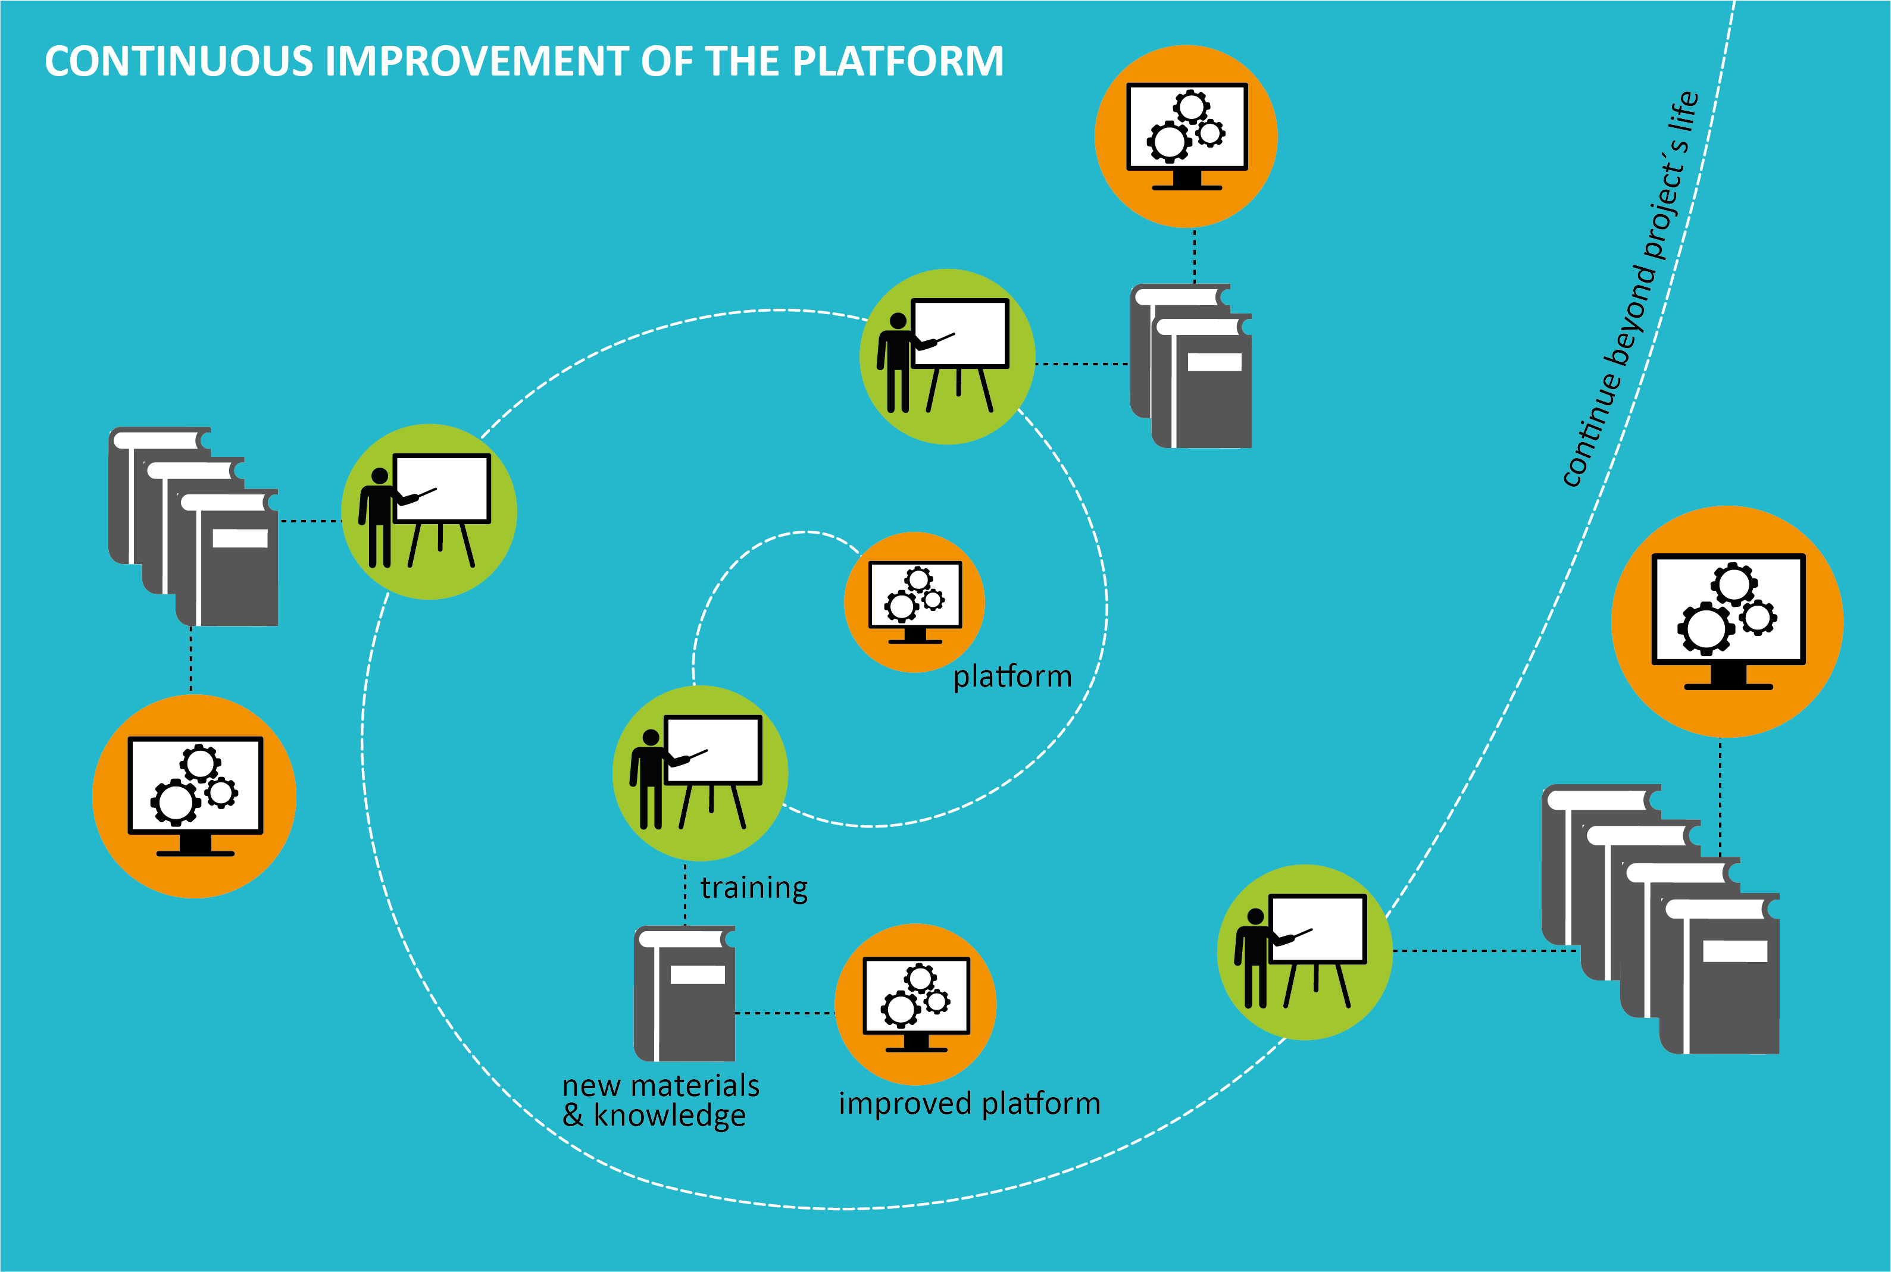
ACTORS OF E2DRIVER
12 pilot companies will engage in the learning programme
Continuous application of self-assessment energy tools and sharing of skills with peers
28 replication companies will apply fine-tuned training methodology
Evaluation of results on the E2DRIVER platform
Dissemination of results through the E2DRIVER platform to financial firms, energy experts, auto companies, etc.
Hub for new ideas
Information on replication of successful interventions in interested companies
Continuous improvements of the method

Slide 17
@E2DRIVERProject
E2DRIVER Project

