Slide 1
Boosting the energy efficiency in the European automotive sector

Slide 2
THE E2DRIVER PROJECT

Slide 3
WHAT IS THE E2DRIVER PROJECT?
E2DRIVER is a project funded by the European Horizon 2020 programme
It aims to boost energy efficiency in the European automotive sector
To that end, small and medium enterprises (SME) will be trained in energy efficiency measures and energy audits
E2DRIVER is focused on 4 countries: Germany, Spain, France and Italy
Its objective is to train 40 companies in total, 10 per country

Slide 4
WHAT DOES THE TRAINING ENTAIL?

Slide 5
WHAT THE E2DRIVER TRAINING ENTAILS
The E2DRIVER training entails a blended learning format: 2/3 online, 1/3 on-site
The training is customizable depending on the needs and interest of the companies.
E2DRIVER offers four different training paths for: Managers, Science and Engineering professionals, Technical Managers and Technicians.
Topics addressed in the training are: applicable legislation, energy efficiency, energy management, energy audits, electric vehicles, etc.

Slide 6
STRUCTURE OF THE TRAINING
The E2DRIVER training is composed of three main parts:
An Adjustment session (5 hours): adjustment of the training to the needs of the company.
Execution of the E2DRIVER training: 15 hours for Managers; 15 hours for Science and Engineering professionals; 15 hours for Technical Managers and 2 hours for Technicians.
Closing session: Virtual reality session (1 hour).
The training lasts 6 weeks: 5 weeks of online work and 1 week during which the on-site sessions are performed.

Slide 7
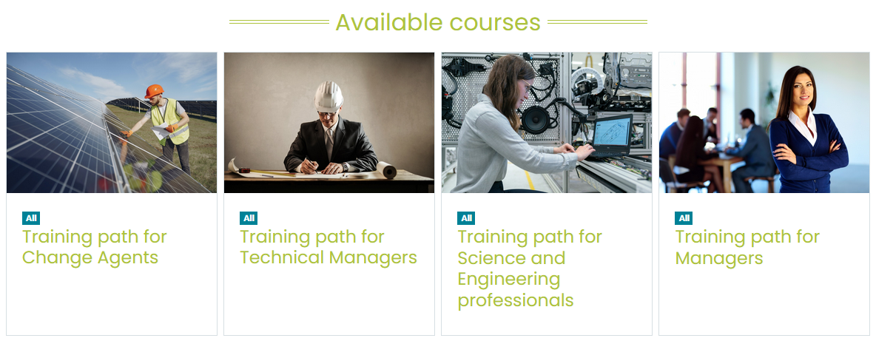
E2DRIVER PLATFORM
An e-learning platform was created for the online part of the training
This platform allows automatic customization. Link: https://e2driver.uv.es/

Slide 8
VIRTUAL REALITY
E2DRIVER has generated a virtual reality exercise in order to teach trainees how to perform measures in an electric cabinet
https://youtu.be/SXzC_gRQB8w

Slide 9
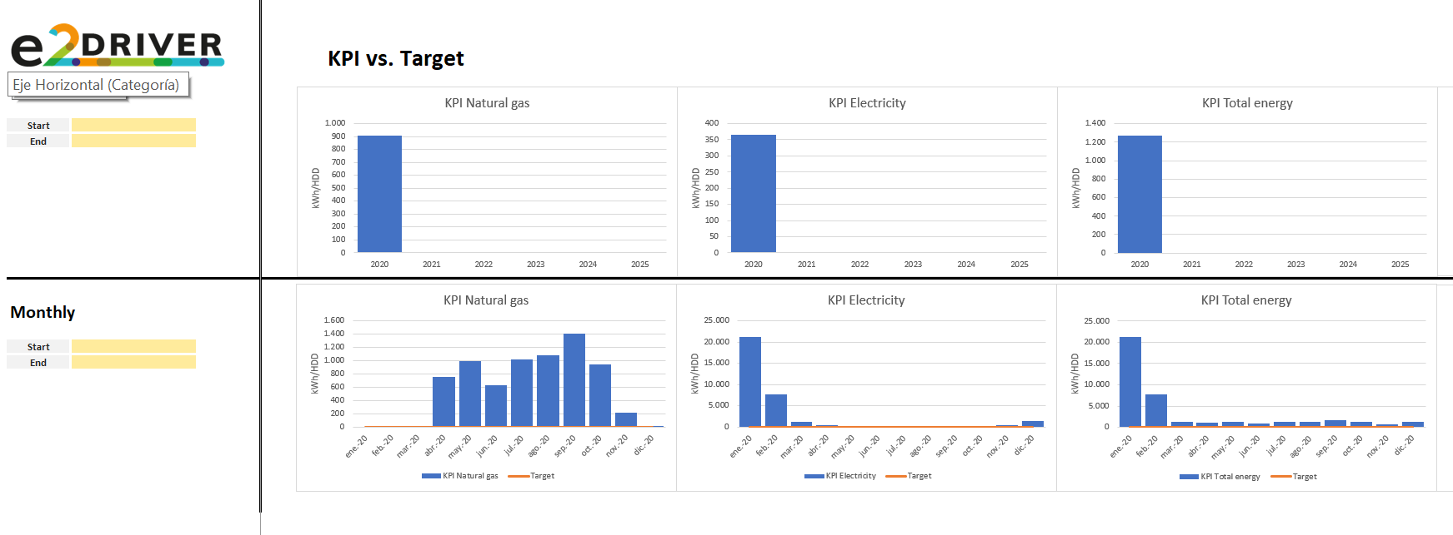
TOOLS
Two additional tools have been integrated into the e-learning platform: the Energy Self-Assessment Tool and the Financial Assessment Tool.

Slide 10
HOW YOUR COMPANY CAN ACCESS THE E2DRIVER TRAINING

Slide 11
DOES YOUR COMPANY WANT YOUR EMPLOYEES TO RECEIVE THIS TRAINING FOR FREE?
IF YOU ARE AN SME FROM THE AUTOMOTIVE SECTOR, YOU CAN PARTICIPATE!

Slide 12
PARTICIPATION REQUIREMENTS
Your company must be an SME.
Your production processes must have significant energy consumption.
Your company has to demonstrate a high interest and commitment in reducing its energy consumption and its environmental impact.
*If you have questions, contact us and we will assess your specific case.

Slide 13
WHAT DO YOU NEED TO DO DURING THE TRAINING?
Provide information about the company: energy and industrial characteristics
Facilitate the execution of the training, permitting trainees to invest the necessary amount of time in the training
Allow E2DRIVER experts to assess the impact of the training in your company

Slide 14
WHAT YOU GET WITH E2DRIVER

Slide 15
WHAT YOU GET WITH E2DRIVER
A customized and free capacity building programme on energy efficiency
By following E2DRIVER recommendations, your company could increase economic and energy savings
Your company and workers can acquire new skills in the field of energy efficiency and energy audits
Additional benefits
Your company will receive advice during the training period
You will receive a training certification
Your students will have priority in E2DRIVER workshops and conferences
Your company could get information about the current state of the sector

Slide 16
WHAT DO I HAVE TO DO TO ENROL FOR THE TRAINING?

Slide 17
ENROLMENT PROCESS
In case you want to be one of the 40 companies that will be trained in the E2DRIVER Project, please write us an email:
mail@e2driver.eu

Slide 18
@E2DRIVERProject
E2DRIVER Project

